Slide 1

ANNAMACHARYA INSTITUE OF TECHNOLOGY & SCIENCES: TIRUPATI
(AUTONOMOUS)
IMPLEMENTATION OF CHATGPT USING
DJANGO
Presented By
P.Muneeswari – 23AK1A0480
T.Pranati – 23AK1A0495
B.Haseena – 23AK1A0437
Department of
Electronics and Communication Engineering

Slide 2
PROBLEM STATEMENT
The growing demand for AI-powered conversational systems has increased the need for intelligent applications that can understand and generate human-like responses.
Integrating advanced language models into web applications can be complex due to backend development and API integration challenges.
This project aims to implement a ChatGPT-based application using the Django framework to provide interactive and intelligent conversations.
The system enables users to submit queries through a web interface and receive context-aware responses in real time.
The project demonstrates the integration of Artificial Intelligence, Natural Language Processing (NLP), and web technologies within a single platform.
It provides a scalable and user-friendly solution for AI-assisted communication and information retrieval.
The implementation helps understand the practical application of large language models in modern web development environments.

Slide 3
METHODOLOGY / APPROACH
Requirement analysis and project planning.
Installation and configuration of Python, Django, and required libraries.
Creation of the Django project and application structure.
Development of the user interface using HTML, CSS, and Django templates.
Integration of ChatGPT/OpenAI API with the Django backend.
Processing user queries and generating AI-based responses.
Testing, debugging, and validation of system performance.

Slide 4
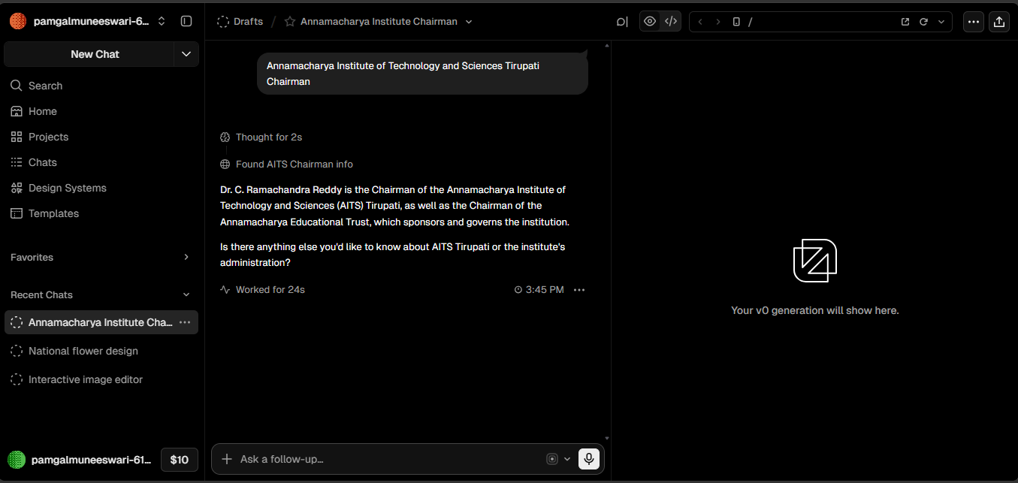
RESULT / OUTCOME
Successfully developed a Django-based web application integrated with ChatGPT.
Users can enter queries through a web interface and receive intelligent responses.
The system provides real-time interaction with an AI language model.
Demonstrated effective integration of AI technologies with web development.
Improved understanding of Django framework, API integration, and conversational AI implementation.

Slide 5
CONCLUSION
The project successfully implemented ChatGPT using the Django framework, creating an interactive AI-powered web application. The system demonstrates how Artificial Intelligence can be integrated into modern web applications to provide intelligent and real-time user assistance. This project enhanced practical knowledge of Django, API integration, and AI-driven application development.

